Slide 1
OPERATIONAL MANAGEMENT LAYER
Operations management is one of the areas inside the ecosystem responsible for designing and controlling the process chains of a data science environment.
This layer is the center for complete processing capability in the data science ecosystem.
This layer stores what you want to process along with every processing schedule and workflow for the entire ecosystem.

Slide 2
We record the following in the operations management layer:
Definition and Management of Data Processing stream
Eco system Parameters
Overall Process Scheduling
Overall Process Monitoring
Overall Communication
Overall Alerting

Slide 3
The Drum-buffer-rope Method:

Slide 7
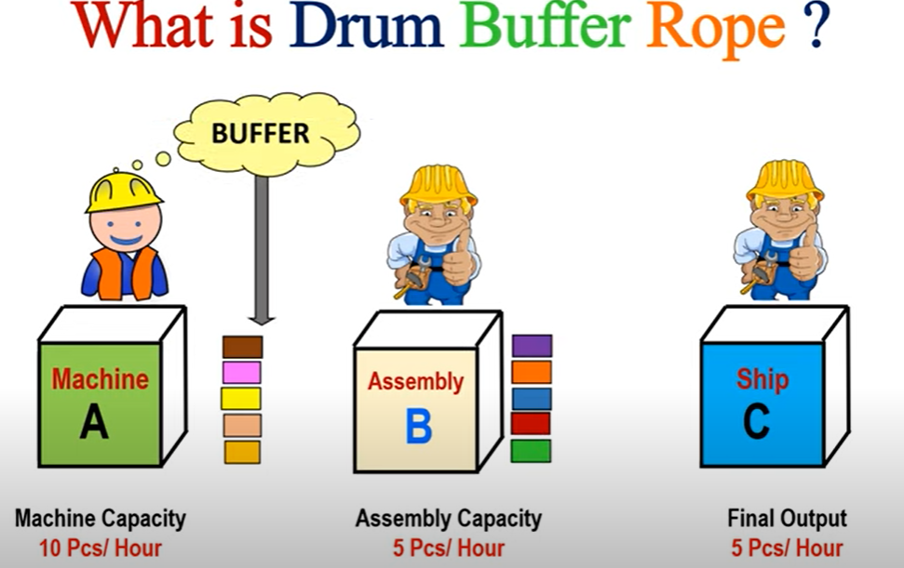

Slide 8
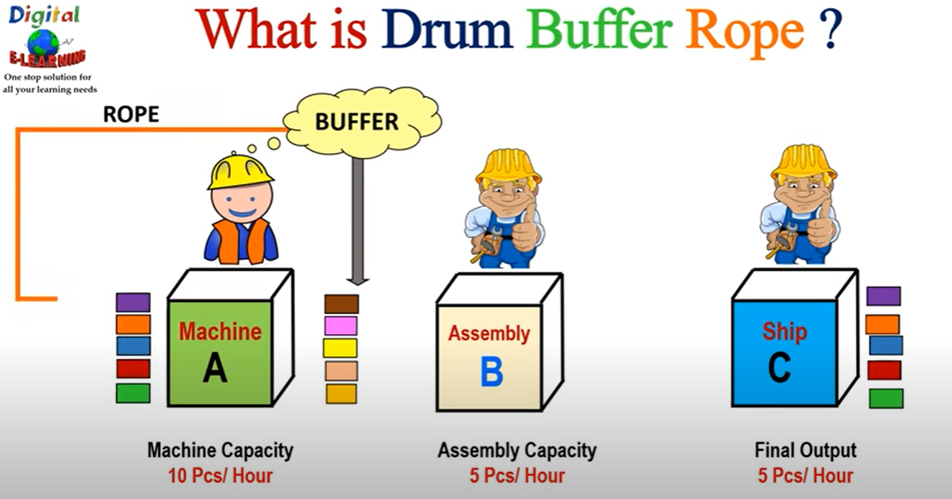

Slide 10
AUDIT, BALANCE, AND CONTROL LAYER
Any process currently under executing is controlled by the audit, balance, and control layer.
It is this layer that has the engine that makes sure that every processing request is completed by the ecosystem according to the plan.
This is the only area where you can observe which processes are is currently running within your data scientist environment.
It records the following information:
• Process-execution statistics
• Balancing and controls
• Rejects- and error-handling
• Fault codes management

Slide 11
The following are good indicators for audit purposes:
Built-in Logging
Debug Watcher
Information Watcher
Warning Watcher
Error Watcher
Fatal Watcher
Basic Logging
Process Tracking
Data Provenance
Data Lineage

Slide 12
Audit:
An audit refers to an examination of the ecosystem that is systematic and independent
This sublayer records which processes are running at any given specific point within the ecosystem.
Data scientists and engineers use this information collected to better understand and plan future improvements to the processing to be done.
the audit in the data science ecosystem, contain of a series of observers which record prespecified processing indicators related to the ecosystem.

Slide 13
Balance:
The balance sublayer has the responsibility to make sure that the data science environment is balanced between the available processing capability against the required processing capability or has the ability to upgrade processing capability during periods of extreme processing.
In such cases the on-demand processing capability of a cloud environment becomes highly desirable.

Slide 14
Control:
The execution of the current active data science processes is controlled by the control sublayer.
The control elements of the control sublayer are a combination of:
the control element available in the Data Science Technology Stack’s tools and
a custom interface to control the overarching work.
When processing pipeline encounters an error, the control sublayer attempts a recovery as per our prespecified requirements else if recovery does not work out it will schedule a cleanup utility to undo the error.
The cause-and-effect analysis system is the core data source for the distributed control system in the ecosystem.

